Slide 1
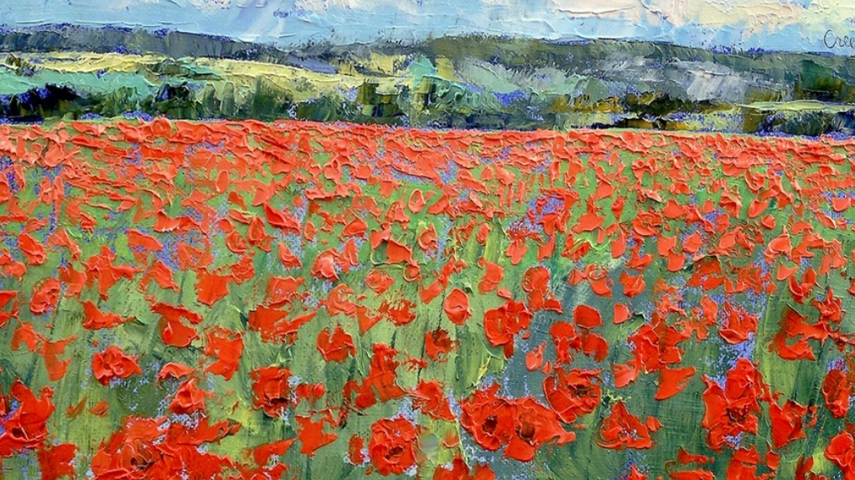
What to Do When the Kids Don’t Want It…
Converting Passion Assets into Charitable Impact
Colleen Boyle, CAP®
Managing Director
Head of Business Development & Philanthropic Strategy
New York
London
Hong Kong
Dubai
Los Angeles
Philadelphia
Charleston
Silicon Valley
Denver
Palm Beach

Slide 2
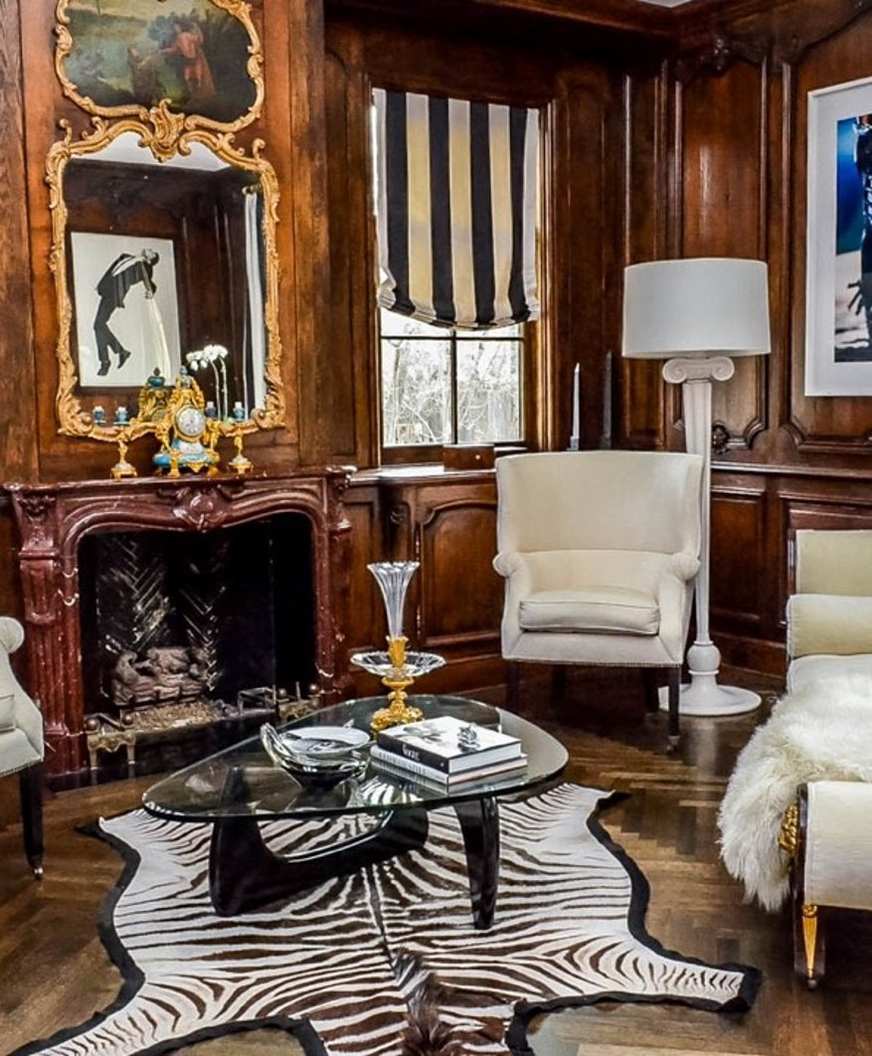
Financial Impact of Luxury Assets
Wealth associated with art and collectibles for UHNW clients is predicted to grow to an estimated $2.9 trillion by 2026.
A conservative average of 10.9% of wealth is allocated to art and collectibles.
Significant wealth can be stored in passion assets that can impact a financial portfolio.
It is important to understand value changes.
Many heirs are not interested in being the custodian of family collections.
Families do not understand that passion assets can be used toward charitable impact.
.
Arttactic/Deloitte

Slide 3

Types of Non-Cash Passion Assets
MOST HIGH-NET-WORTH CLIENTS HAVE A PASSION THAT
THEY MAKE PART OF THEIR INVESTMENT PORTFOLIOS
Fine Art
Collector Cars
Antiquities
Firearms & Armor
Books & Manuscripts
Clocks
Couture & Accessories
Furniture
Instruments
Sporting Memorabilia
Jewelry & Watches
Pop Culture
Photography
Rugs & Carpets
Silver
Wine
Coins & Stamps
Historical Documents
Other Valuable Objects

Slide 4
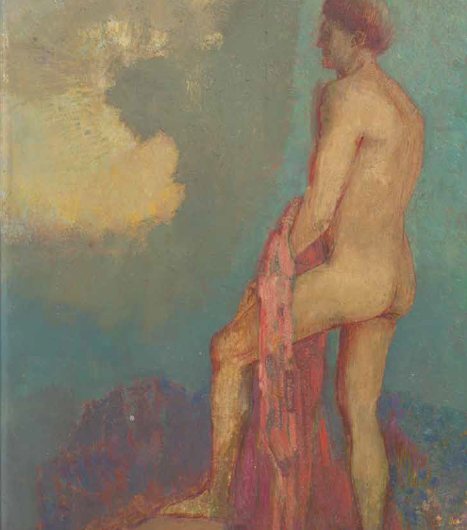
Top 5 Mistakes Made When Planning for Art and Other Collectible Assets
  Failure to Plan.
  Not realizing the true value.
  Not having conversations with heirs or beneficiaries.
  Not using a team of experts.
  Not fully discussing the potential for Charitable Giving.

Slide 5
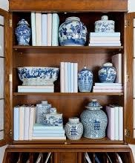
Why Communication is Important?
Which one is…..
Ming Dynasty jar?
19th century European jar?
Pier One Import jar?
Rare blue-and-white bowl from China's Ming dynasty
purchased for $35 at garage sale.

Slide 6
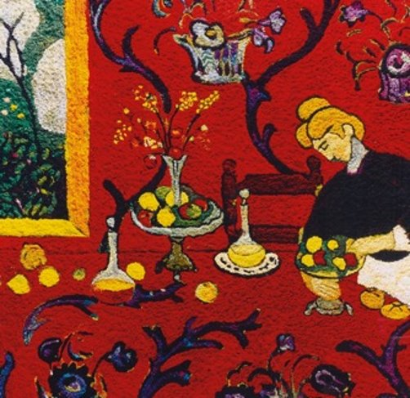
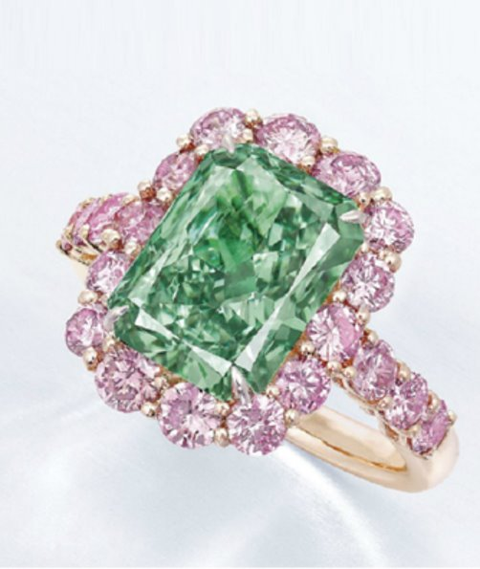
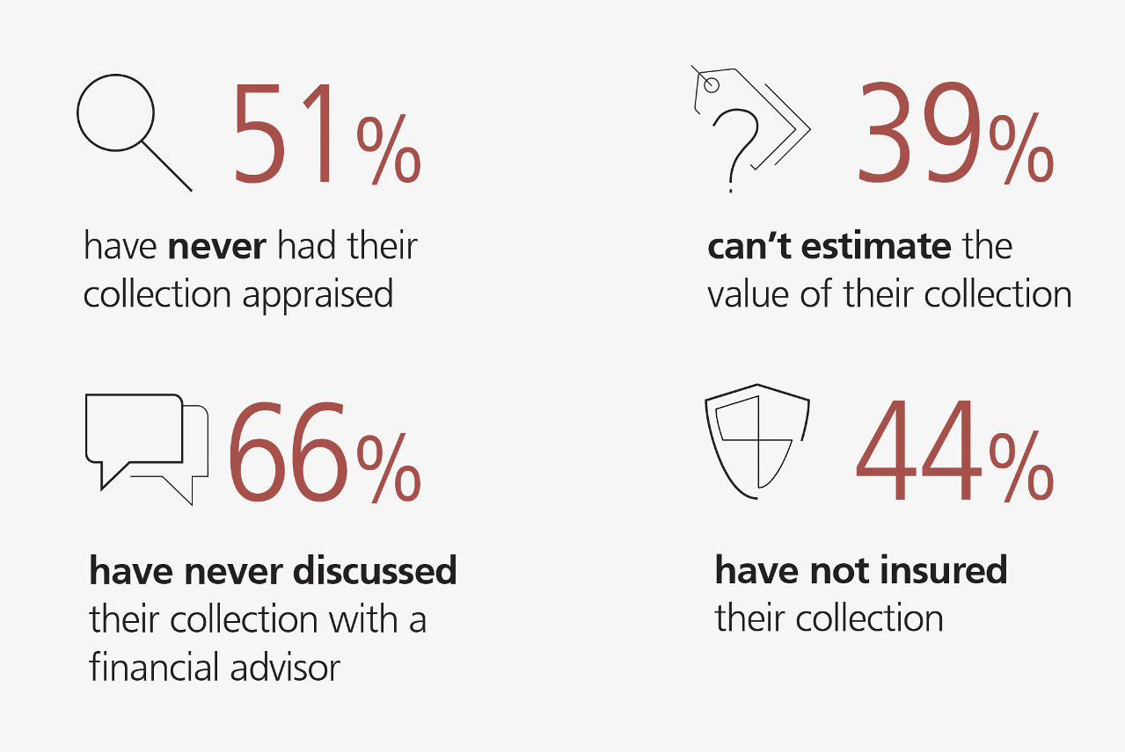

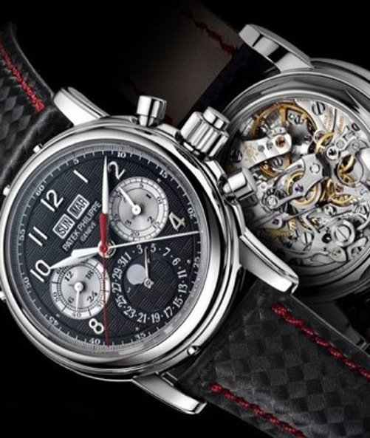
What is the true value of a collection?
Notes:
The Fine Art Group/Hagerty
Why should collectors discuss tangible or passion assets with advisor and more importantly why is it important to plan for these assets?

Slide 7
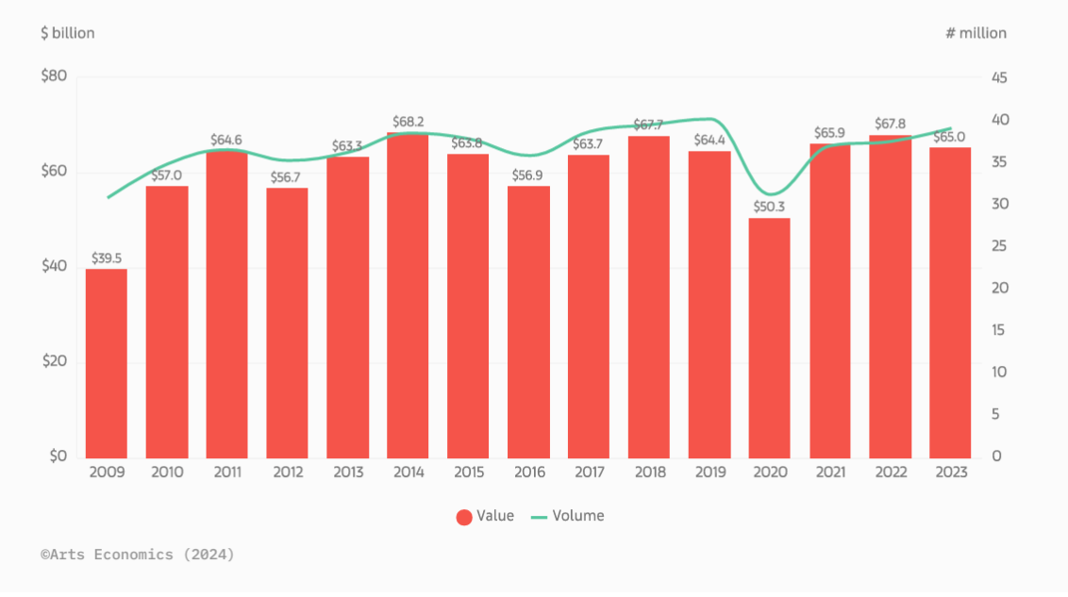
Sales in the Global Art, Jewelry, & Collectible Market 2009-2023
Notes:
Against a backdrop of high interest rates, inflation, and political instability, sales were thinner at the top end of the market, and the performance of some of the major art markets diverged. Although they were down year-on-year, values remained above the pre-pandemic 2019 level of $64.4 billion. The US maintained its position as the leading market worldwide, accounting for 42% of sales by value, down by 3% year-on-year. China, including Mainland China and Hong Kong, became the second-largest global art market, with its share rising to 19%, while the UK fell back to third place with a share of 17%. France remained in a stable fourth position at 7%.

Slide 8
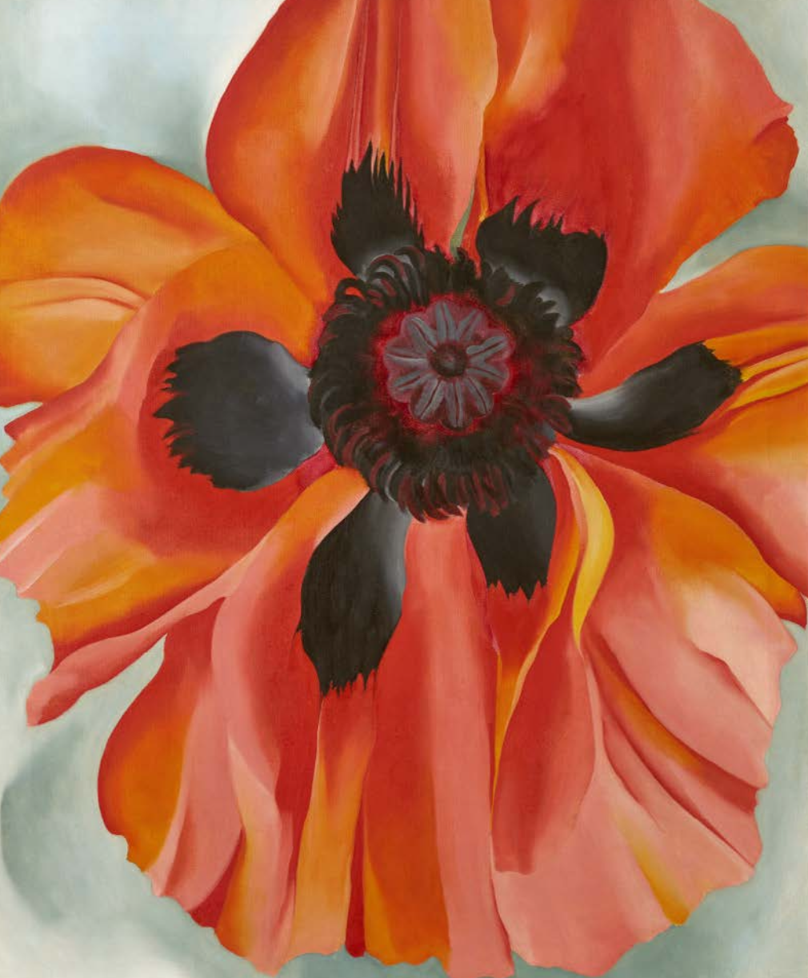

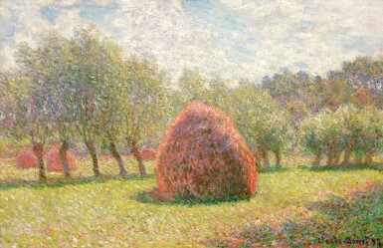
What’s Hot in the Art Market?
BLUE CHIP
FEMALE ARTISTS
ARTISTS OF COLOR
Claude Monet
Meules à Giverny (1893)
Sold at Sotheby’s for $34.8 million
Georgia O’Keeffe
Red Poppy (1928)
Sold at Christies for $16.5 million
Kerry James Marshall
Vignette #6
Sold at Sotheby’s for $7.48 million

Slide 9
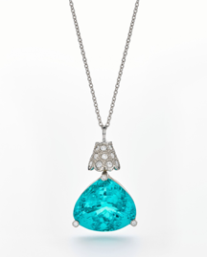
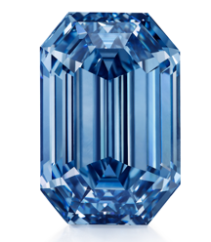
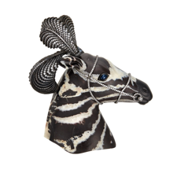
What’s Hot in the Jewelry Market?
Three areas of strength
Colored Diamonds
The market value of fancy-colored diamonds has typically increased 9-12% annually in recent years.
Luxury Makers
Jewelry by important makers such as Harry Winston, Cartier, Van Cleef & Arpels, Jar, Tiffany and Bulgari are in demand.
Rare and Unusual Stones
Unusual specimen stones such as paraiba tourmalines and spinels have seen increased interest and appreciation on the market due to demand from Asia.

Slide 10
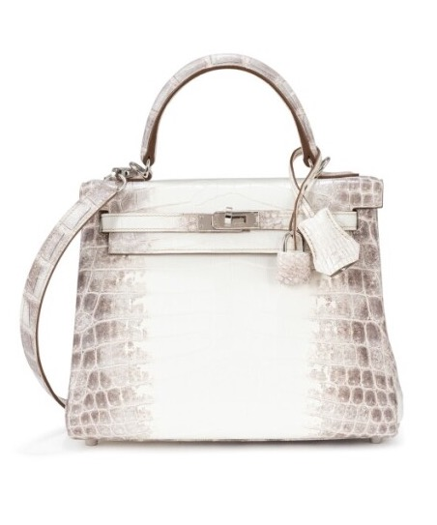
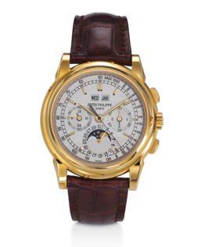
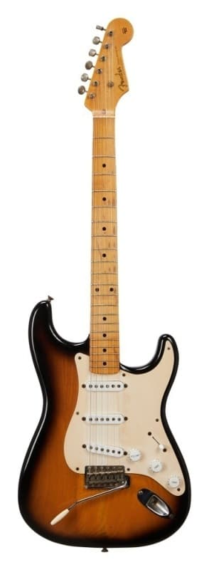
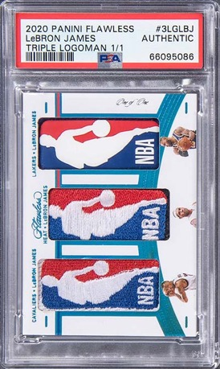
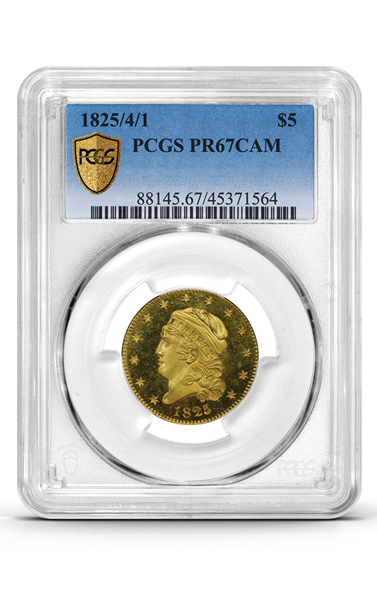
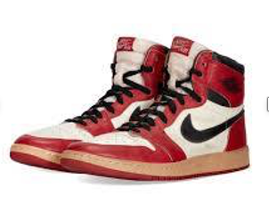
Other Luxury Assets
HERMÈS
Blanc Matte Himalaya
Niloticus Crocodile Kelly 25
Sold for $345,000 at Sotheby’s
PATEK PHILIPPE
18K Yellow Gold Perpetual
Calendar Chronograph
Sold for $264,000 at Christies
2020-21 PANINI FLAWLESS TRIPLE LOGOMAN LEBRON JAMES 1/1
Sold at Goldin Auction for $2.4 million
Grade: PSA Authentic
1954 FENDER STRATOCASTER SUNBURST GUITAR
Sold for $130,000 at Julian’s
ROMANÉE CONTI 1990 DOMAINE DE LA ROMANÉE-CONTI
(9 bottles), sold for $450,590 Sotheby’s.
MICHAEL JORDAN’S Game-Worn Original 1985 Air Jordan 1 ‘Chicago’ Sneakers
Sold for $189,000 at Christies
1825/4/1 CAPPED BUST HALF EAGLE,
PCGS PR67CAM
Sold for $4.08 million at Stacks Bowers

Slide 11
Managing Passion Assets through Multiple Generations
Options for the disposition of art, jewelry and valuable collectibles:
  GIFT
  Transfer part or all the collection to family or other non-charitable beneficiaries.
  DONATE
  Transfer part or all the collection to charity.
  SELL
  Sell part or all the collection.
The default ‘do nothing’ alternative can be a financial and emotional burden on beneficiaries and very expensive when settling the estate.

Slide 12
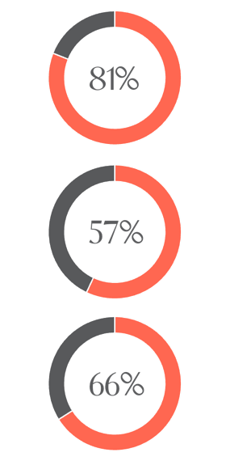
Most Collectors intend to leave their collections to their heirs…
plan to leave their collection to their heirs when they pass away.
BUT...
have not taken steps to educate their heirs on how to manage, appraise or sell their collection.
EVEN THOUGH...
believe it is very easy to get taken advantage of when buying or selling collectibles.

Slide 13
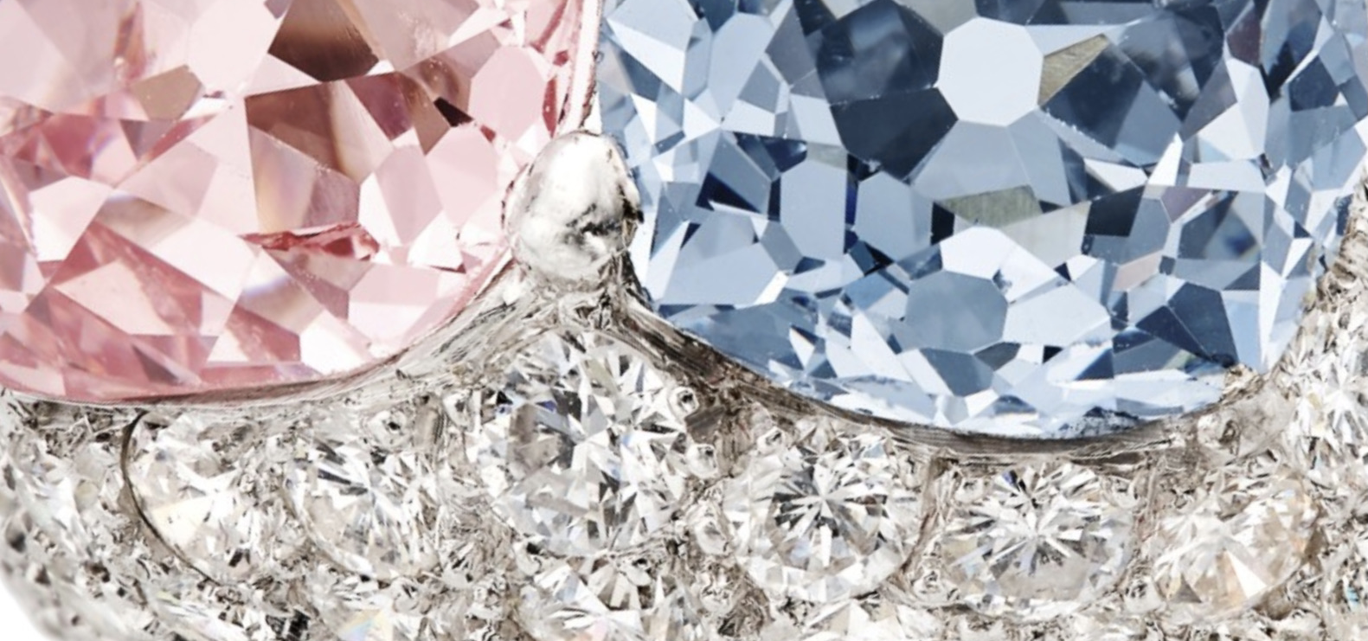
Myth Busting
The heirs want the collections
The museum wants and will display the artwork​
There is NOT related use, so less attractive tax benefit
(cost basis vs fair market value)​
The sales results will be the same at any auction house​​

Slide 14
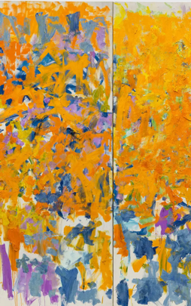
Three Key Themes in Philanthropy with Passion Assets
1. Generosity Amid Challenging Times (Giving while Living)
  Upward trend in philanthropic giving & building a family legacy.
  Focus on directing wealth to philanthropy.
2. Increased Sophistication of Donors
  Donors are increasingly interested in smarter, more strategic ways to give back.
  Donors want to take advantage of tax benefits and favorable market conditions when available to them.
  Fastest-growing charitable giving vehicle is the donor-advised fund.
3. The Next Generation Leads the Way
  Millennials consider themselves philanthropists.
  The growing popularity of impact investments signals a shift that the next generation is driving from charitable giving to charitable living.
  Reliance on experts.
Notes:
. Generosity Amid Challenging Times (Giving while Living)
Upward trend in philanthropic giving & building a family legacy.
Focus on directing wealth to philanthropy.
2. Increased Sophistication of Donors
Donors are increasingly interested in smarter, more strategic ways to give back.
Donors want to take advantage of tax benefits and favorable market conditions when available to them.
Fastest-growing charitable giving vehicle is the donor-advised fund.
3. The Next Generation Leads the Way
74% of Millennials consider themselves philanthropists—compared to just 35% of Boomers.
The growing popularity of impact investments signals a shift that the next generation is driving from charitable giving to charitable living.
The next generation will lean on experts.

Slide 15

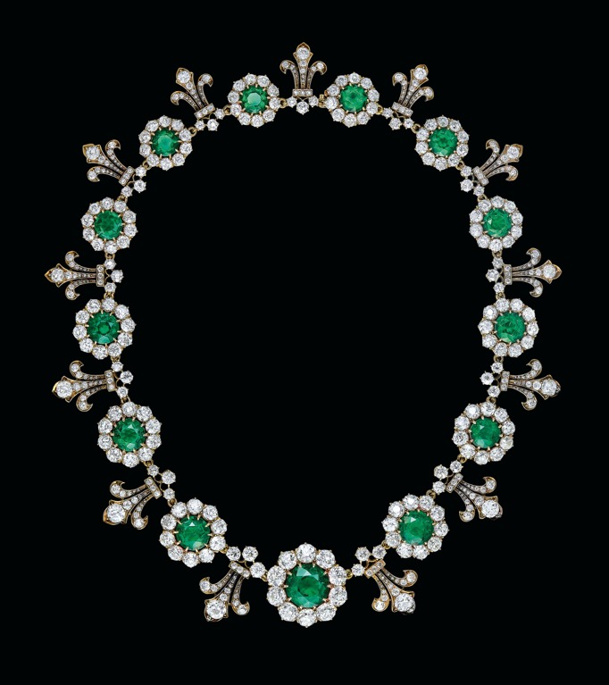
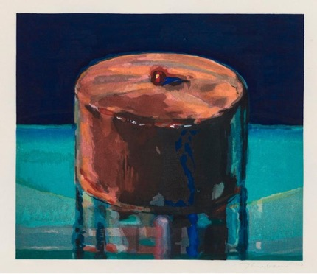
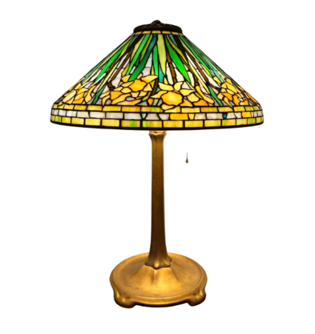
Benefits of Lifetime Donation
Making a charitable vision become a reality
A solution for family members who are not interested in the objects (s).
Avoid paying capital gains tax.​
Remove an appreciated illiquid asset(s) from the estate for estate tax purposes.
Contributing toward charitable causes during lifetime.
Educate next gen on philanthropic giving while living using passion assets.

Slide 16
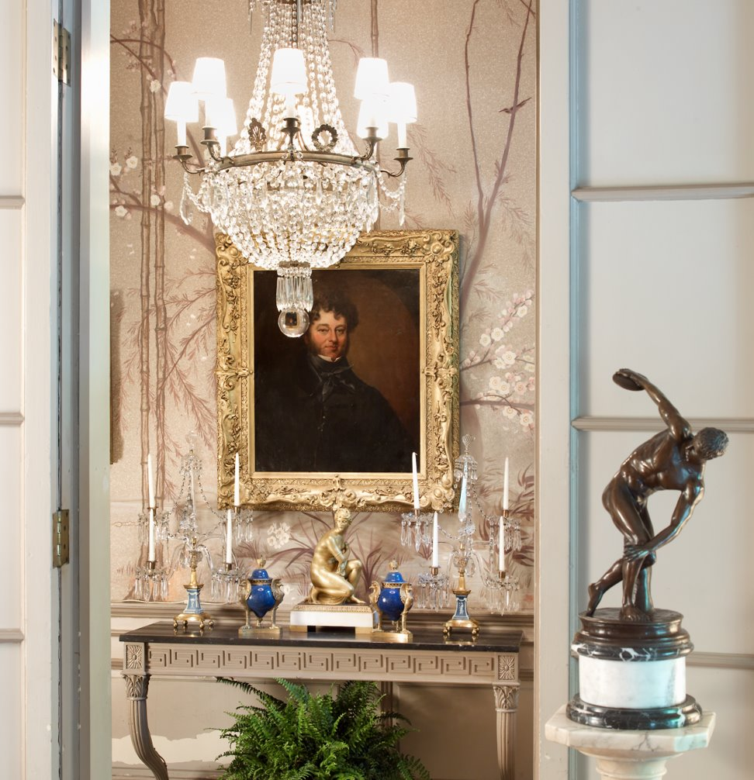
Legacy Creation:
An important conversation to have with clients
Making your charitable vision become a reality
Is your client interested in donating all or part of the collection to an institution?
Is your client interested in selling all or part of the collection and allocating the proceeds to a specific charity, multiple charities or using the proceeds toward social impact investing?
Has your client considered gifting all or part of the collection to a Donor Advised Fund and using the proceeds from the sale to allocate to charitable endeavours?
Is your client thinking of creating a Museum for the collection or a contributing to a private Foundation or a Charitable Remainer Trust?

Slide 17
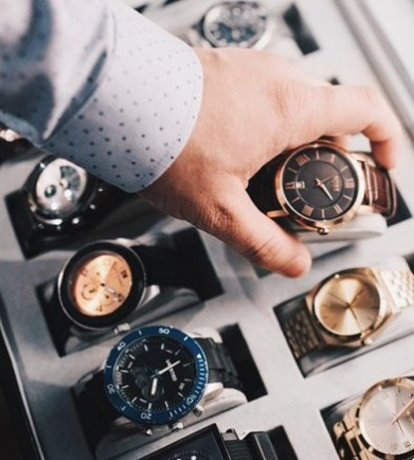
Case Study 1:
Depreciated Passion Assets
Over several years, the patriarch acquired a large watch collection. When he passed, his spouse received the collection. Neither the children nor grandchildren have an emotional attachment to the collection.
The matriarch and family members are very philanthropic. The matriarch decided to use the watch collection to support various charities during her lifetime focused on education and homeless issues.
Since the collection had depreciated since getting a step up basis, the matriarch decided to sell the collection in a specialty watch sale and then contributed part of the proceeds directly to a specific charity and the remaining proceeds to the DAF.

Slide 18
Case Study 2:
Passion Asset Donated to Charity
Client owned a necklace and there were not any heirs. The value of the necklace had increased over time and the client did not want to pay capital gains. However, the client wanted to support a charity that focused on children’s health issues during lifetime. The client donated the necklace directly to the charity and The Fine Art Group was the sales agent for the charity. The necklace sold for $750,000 and the proceeds were allocated to the charity.

Slide 19
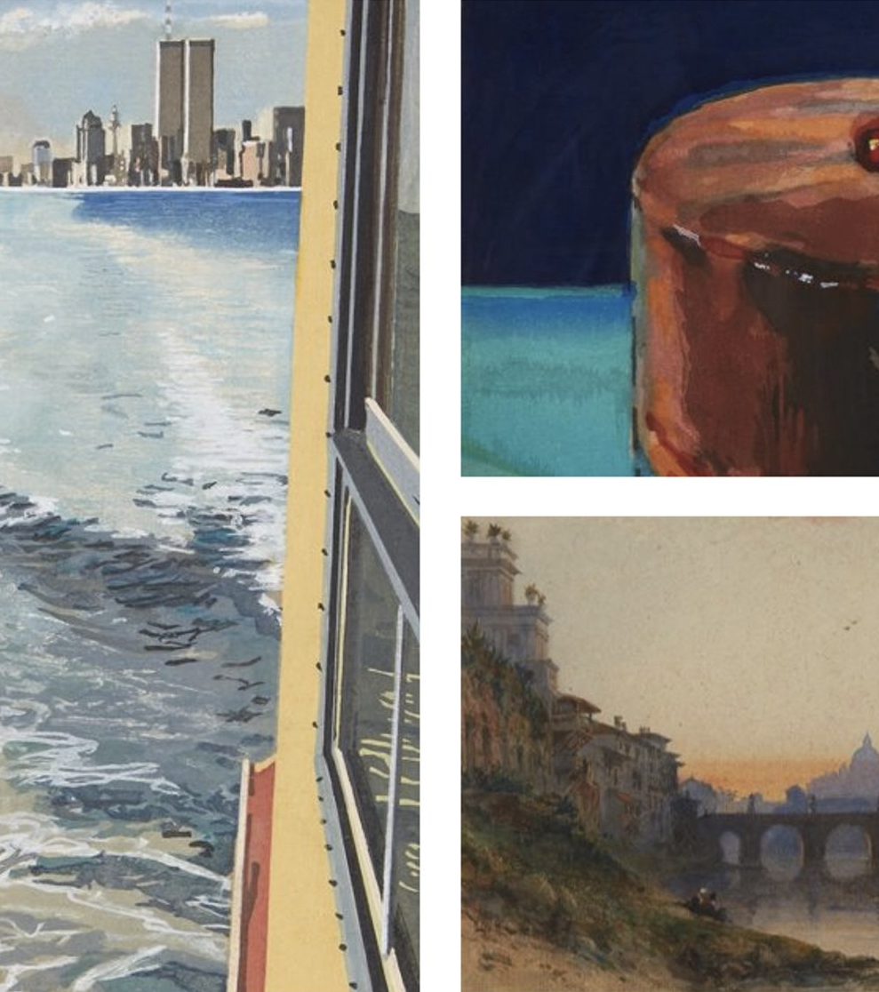
Case Study 3: Legacy Scholarship
A husband and wife collected paintings and watercolors from highly regarded European and American artists. They also collected Tiffany lamps.
When the wife fell ill, the family decided to part with their curated collection and with the proceeds fund a scholarship in the matriarch’s name at her alma mater.
The matriarch was the first of her family to go to college, an opportunity that would not have been possible without the financial assistance her scholarship provided.
A single Owner Sale was created with proceeds going to the Scholarship Fund.

Slide 20

Case Study 4: ​
Family Creating a Legacy using a DAF​
A client collected modern literature books and autographs for the past 25 years.
The collector was very charitable and when he passed away, the family wanted to create a legacy using the book collection.
A Single Owner sale was organized and the family gifted the collection to a donor Advised Fund. The collection sold and all proceeds were allocated to their Donor Advised Fund (DAF) to be distributed to various charities.

Slide 21
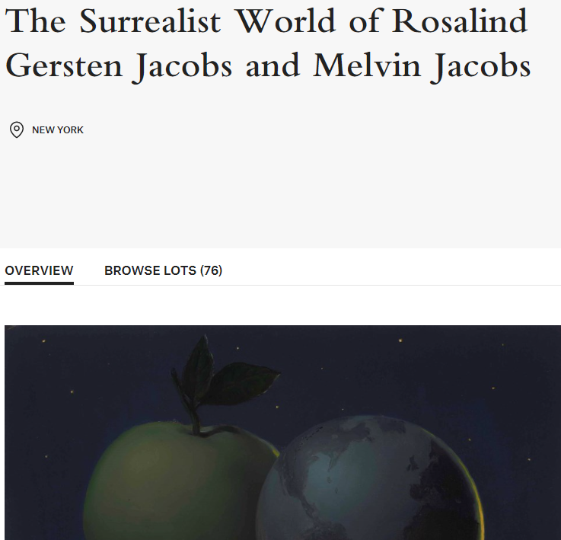
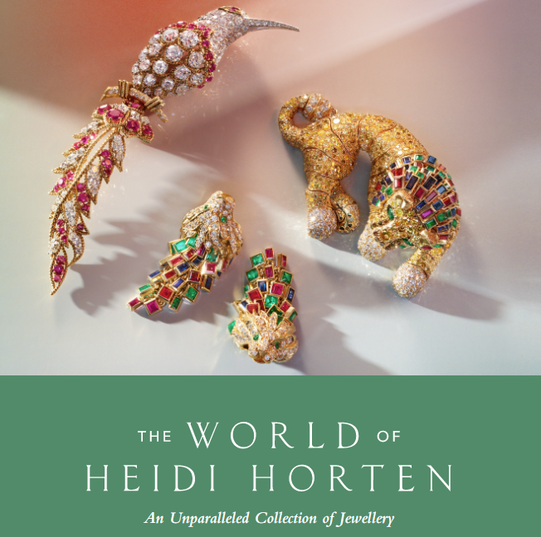
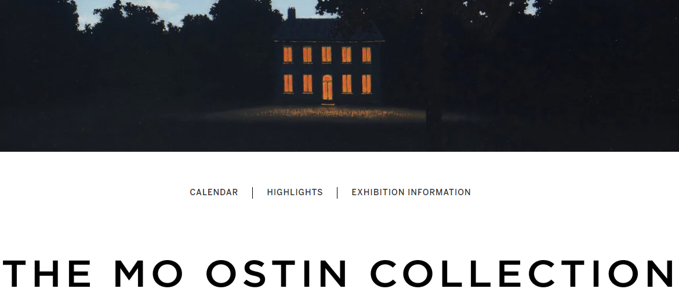
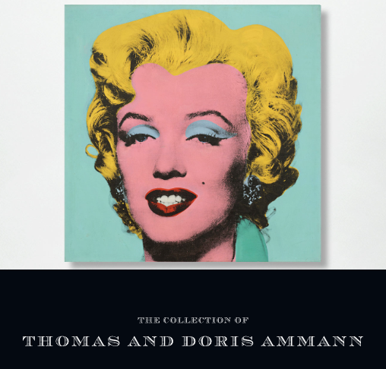
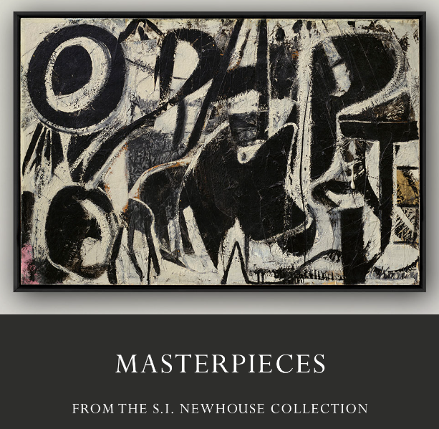
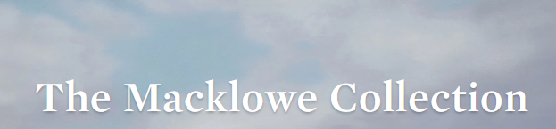
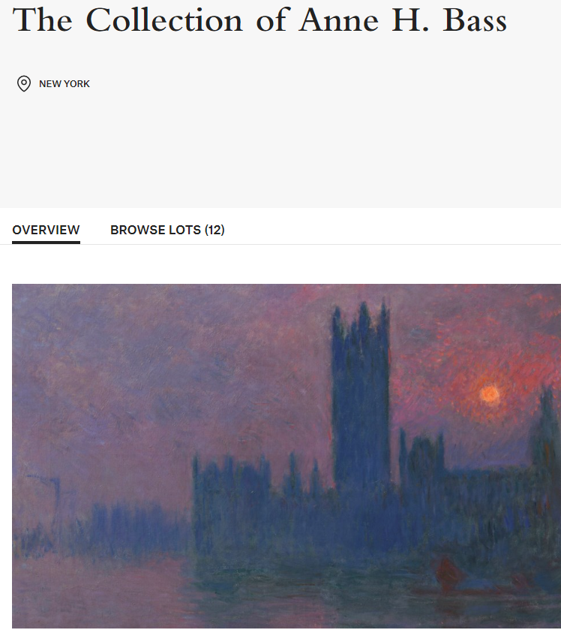
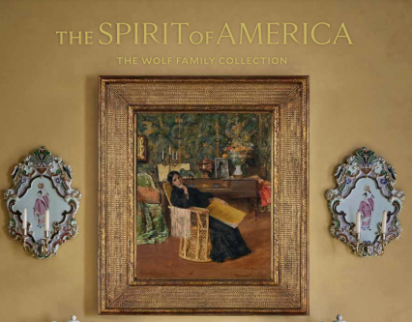
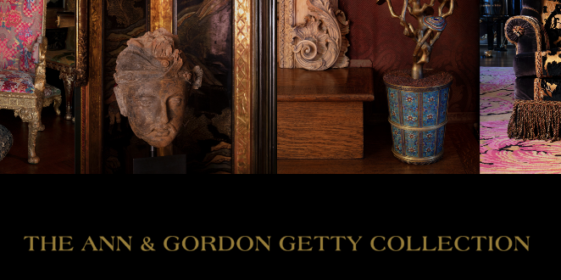


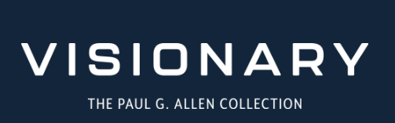
The New Reality: The Single Owner Sale

Slide 22
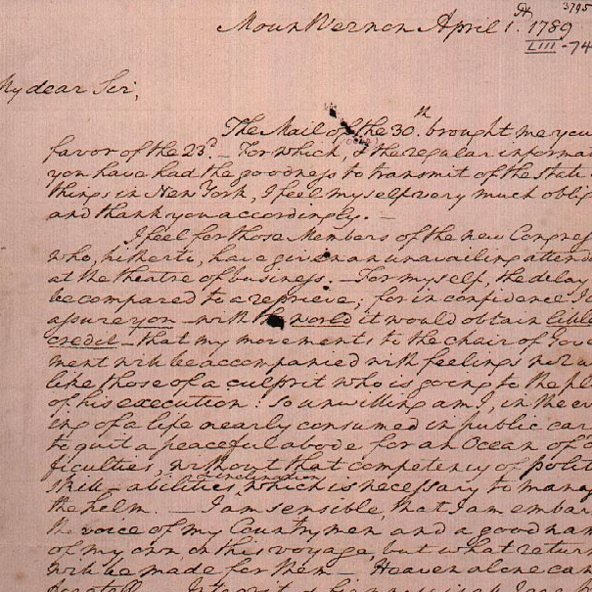
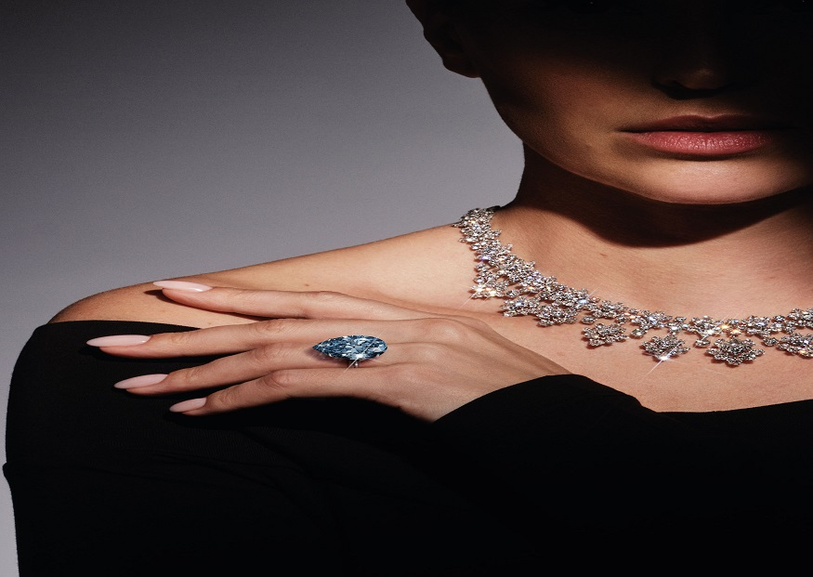
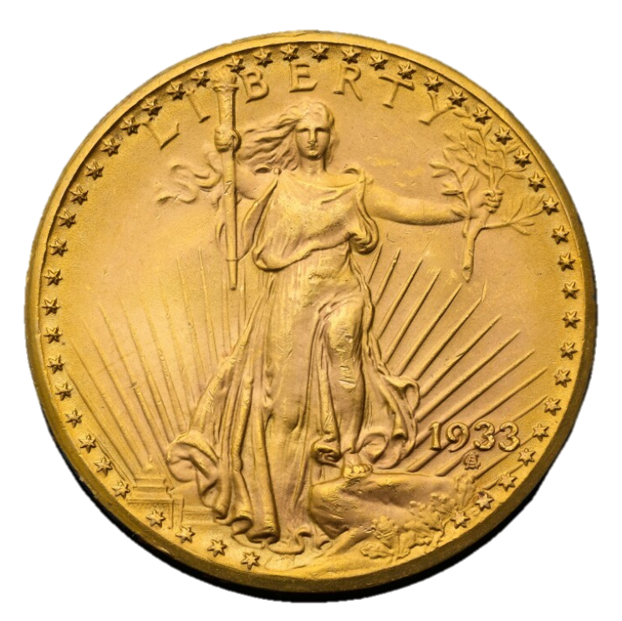
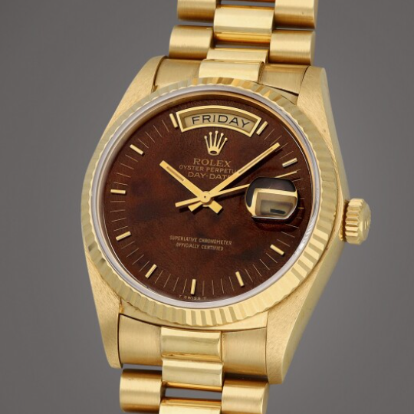
The Sales Process
Selling with a purpose
Review Object/Collection to be sold
Determine if Object(s) has appreciated in value compared to cost basis.
Create the sales strategy (identify venue for sale, negotiate fees, identify appropriate sale and geographic location, discuss reserves)
Execute Sales strategy
Proceeds deployed to Charity, Foundation or Donor Advised Fund for charitable impact.

Slide 23
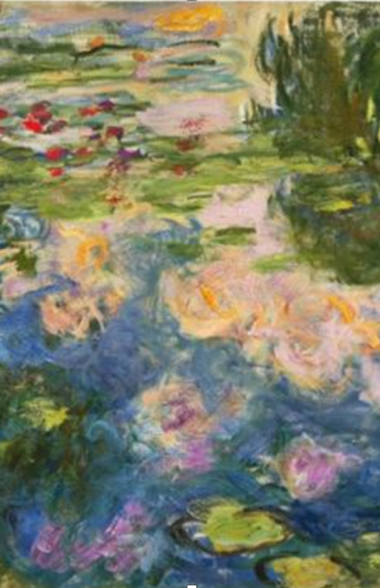
Final Thoughts
Discuss the donor’s goals and wishes. This will help to mitigate future complexities and surprises.
Have a plan for collections and non-cash passion assets.
Understand the emotional and financial value of objects/collections.
Pass on Values not just Valuables. Unlock the value of passion assets to create a legacy and support charitable causes.
It takes a TEAM

Slide 24
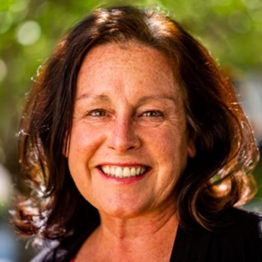
Contact
DIVERSE, IN- DEPTH, 360° KNOWLEDGE LIKE NO OTHER.
We pride ourselves on our team’s honesty,
expertise and knowledge.
Colleen Boyle CAP®
MANAGING DIRECTOR
BUSINESS DEVELOPMENT​ & PHILANTHROPIC STRATEGY
colleenboyle@fineartgroup.com
610-470-5340 (mobile)
610-254-8400 (0ffice)

Slide 25







Appraisals
track record in the art market
¹
in value of artworks transacted
of combined experience of the executive team
²
worth of artworks and collectibles valued in 2021
Across 7 departments and 5 global offices
CSSF Luxembourg & Jersey Financial Services Commission
In-depth, comprehensive, and market-orientated valuations
Art Advisory
Tailor-made acquisition strategies combining market-leading insight with clear and transparent advice
Sales Agency
Custom-built sale strategies to maximize value and efficiency; market strategy and sales process management
Lending
Art asset-backed loans with flexible and bespoke financing structures and terms
Art
Investment
Co-Investment opportunities, art investment funds and other managed art portfolio services
High-quality, collection-specific solutions that helps Sports & Entertainment industry executives make informed decisions around the strategic long-term management of their fine art, jewelry, and other high value collectibles
High Profile
Philanthropy
We provide strategic guidance on converting passion assets into charitable impact.
¹Represents sales, purchases, guarantees, and financing transactions through 31 Dec 2021, excluding transactions executed by the US affiliate; ail Replacement Value appraisals; ²Sum of Fair Market Value and Ret

Slide 26
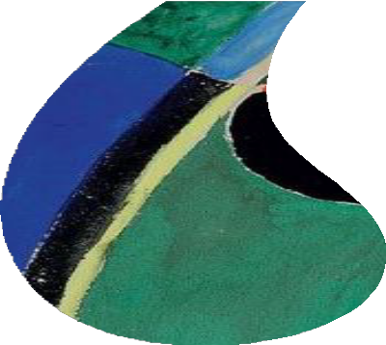


THANK YOU
STRICTLY PRIVATE AND CONFIDENTIAL
FINEARTGROUP.COM

